Slide 1
Software
Requirements Specification
Sparx Systems Webinar

Slide 2
Take Orders – Table Display
Name | Notes
REQ012 - Provide Online Sales | A new on-line book ordering system is required. This will allow web users to browse and purchase books from the current inventory. Pre-orders will not be required.
REQ014 -ShoppingBasket | A shopping Basket facility is required.
REQ015 -Process Credit Card Payment | All payments will be via credit card. All major credit card types will be accepted and approval time shall be less than 2 minutes except where fraud checks fail.

Slide 3
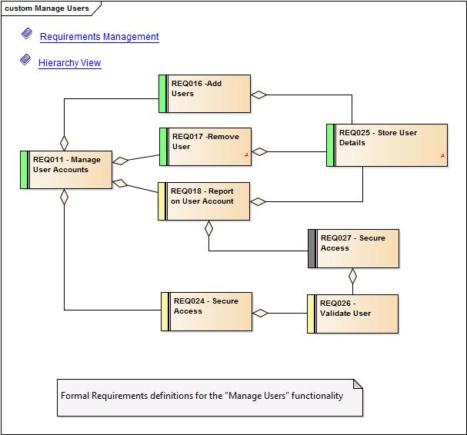
Mange Users - Diagram

Slide 4
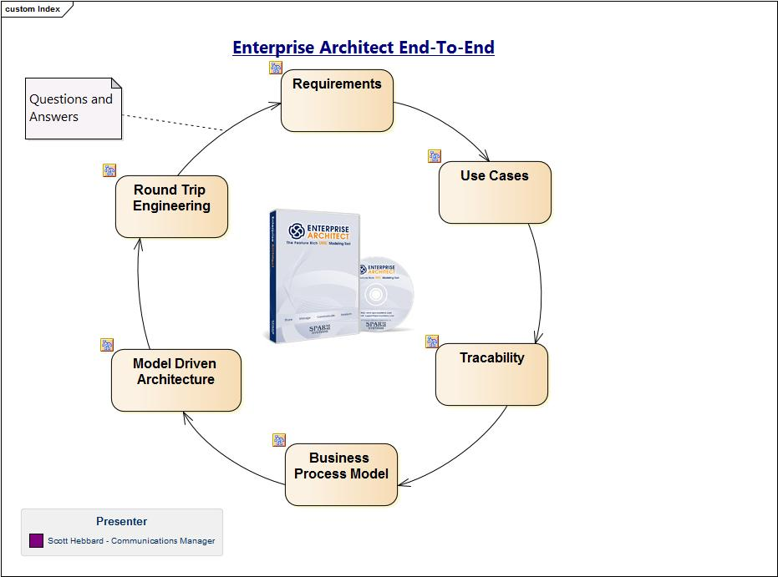
Overview of Enterprise Architect

